Slide 1
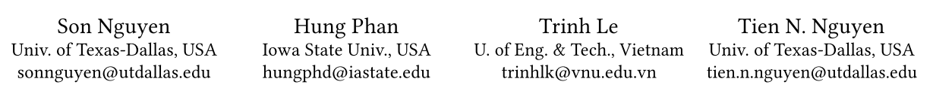
Suggesting Natural Method Names to Check Name Consistencies
ICSE-2020
刘芳
2020-04-29

Slide 2
Introduction
Misleading names for program entities in a regular program or the APIs in a software library confuse engineers on API usages, leading to misuses and defects.
Recognizing the importance of meaningful names, researchers have introduced automated tools to verify the consistency between the methods’ names and their bodies, and then to suggest succinct names for inconsistent methods.
IR direction: two methods with similar bodies should have similar names. Searching for the names of the methods with similar bodies to suggest for an inconsistent method [1].
two methods with the same bodies are given different names or two of them with the same names have different bodies, because they are in different contexts or for different tasks/purposes.
cannot suggest a new name that it has not seen before.
[1] Learning to Spot and Refactor Inconsistent Method Names. (ICSE-2019)

Slide 3
Introduction
Misleading names for program entities in a regular program or the APIs in a software library confuse engineers on API usages, leading to misuses and defects.
Recognizing the importance of meaningful names, researchers have introduced automated tools to verify the consistency between the methods’ names and their bodies, and then to suggest succinct names for inconsistent methods.
Machine learning direction: code2vec [2] suggests a name for a given method with the key idea that two methods with similar AST structures should have similar names.
two methods implemented with different AST structures (e.g., for versus while) can perform the same task, thus, can be given the same name.
not capable of generating a new name for a method.
[2] Code2Vec: Learning Distributed Representations of Code. (POPL-2019)

Slide 4
Introduction
In this paper, we introduce MNire, a machine learning approach to check the consistency between the name of a given method m and its implementation.
Based on the contexts of the body, the interfaces, and the enclosing class’ name, MNire first generates a name and compares m’s current name against it. If they are sufficiently similar, m is considered as consistent, otherwise it is inconsistent.
A. Empirical Study: we first conducted an empirical study to learn the relation between the tokens composing the names of the entities in the contexts and the tokens of the method names.
B. Representation and Tool: based on the results of our study, we developed a novel approach/tool to recommend method names and to detect method name inconsistencies.

Slide 5
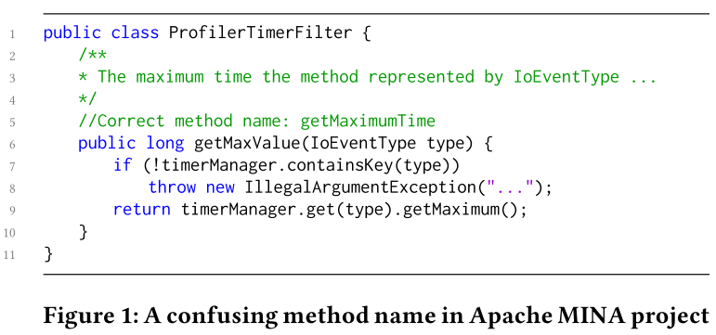
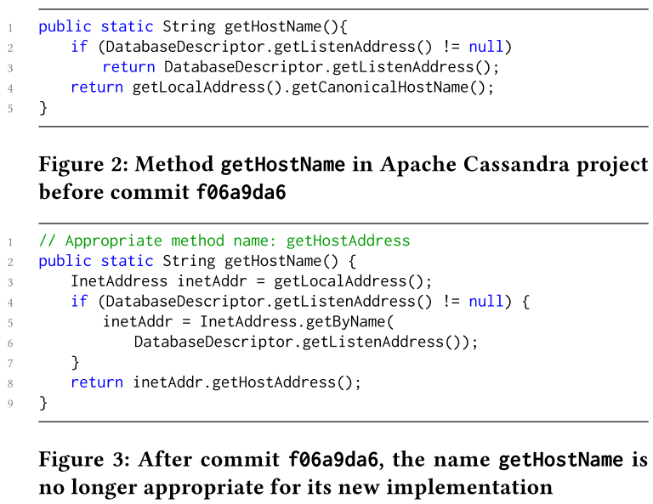
Motivating Examples
Method Name Inconsistency

Slide 6
Motivating Examples
Observations and Approach Motivation
the method’s name, that abstracts the method’s purpose, and the names of the program entities used to implement the method’s body, have a relation with regard to the description of the method’s functionality.
the method’s name and the name of a variable, field, or method call in the body could share parts relevant to the method’s functionality.
the tokens composing the good method name and those of the program entities in the body often co-occur.
the parts of the good name getMaximumTime can be found in the variables’ names or method calls in the body, e.g., getMaximum, timerManager
This suggests that encountering the tokens of the entities in the method body can provide an indication to predict the tokens of the good method name.

Slide 7
Motivating Examples
Observations and Approach Motivation
the interface context can affect the name of the method, and they can be used for the name suggestion.
For example, in the class FileUtils of Apache Commons IO library, the method copyURLToFile takes two parameters source and destination of the types of URL and File respectively, and is used to copy bytes from source to destination.
the class (called enclosing context) can be used to help infer the name of the contained method.

Slide 8
Empirical Study
RQ1: What are the characteristics of method names regarding their uniqueness and sizes?
RQ2: How is the relation between method names and the implementation, interface, and enclosing class contexts in a program?
Data collection and processing
We used the dataset of 14,317 top-ranked, high-quality, long-history Java projects on GitHub, that was used in a prior work [1]. This dataset includes 2,127,355 files and 17,012,754 methods.
For each method in the dataset, we collected the method’s name, the parameters’ names and types, the return type, the class name, and the names of the variables, fields, and method calls within the body of the method.
Tokenized each of those names using Camelcase and underscore naming conventions, and the tokens are normalized to lowercase.
[1] Mining source code repositories at massive scale using language modeling (MSR-13)

Slide 9
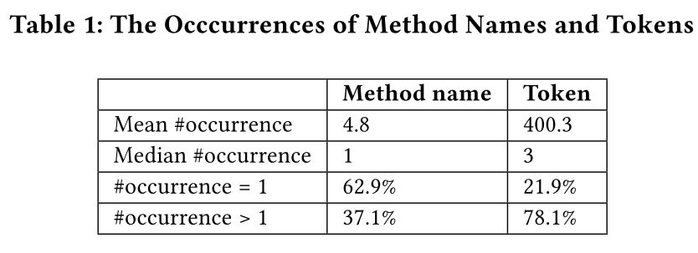
Empirical Study
Uniqueness and Sizes of Method Names
In our dataset, there are 3,402,550 unique method names and 120,303 unique tokens in method names.
for method names, nearly 2 out of 3 names (62.9%) are unique. This leads to that a high number of method names (≈ 2/3 of the names) cannot be identified by searching in the set of cases that are previously encountered.
3 out of 4 tokens (78.1%) used to comprise a method name are likely to be previously seen as parts of other method names.
These above results support us to use a generative summarization approach to learn the tokens composing method names from the tokens that are previously encountered in other method names.

Slide 10
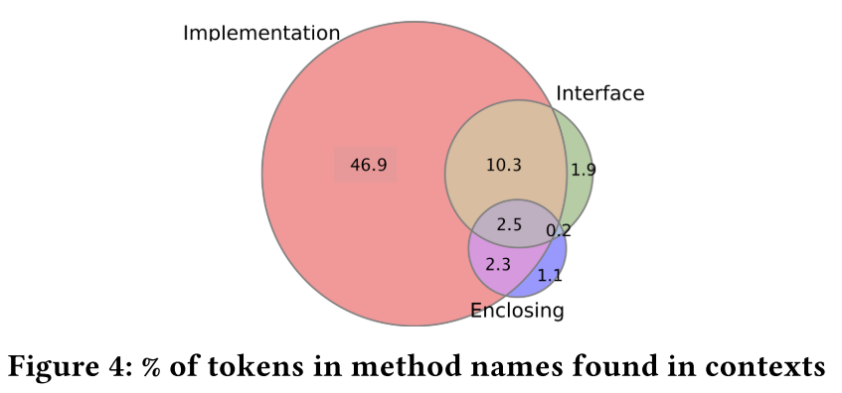
Empirical Study
Method Names and Contexts
Common tokens shared between a method name and the contexts.
On average, about 2 out of 3 tokens of a method name can be found in the three contexts. The highest percentage of the tokens in a method name is found in the body (62.0%), while the next ones are in interface context (14.9%) and enclosing context (6.1%).

Slide 11

Empirical Study
Method Names and Contexts
The conditional occurrences of tokens in the method names on the contexts.
For a method, we computed the conditional occurrence as the conditional probability that the token t is used in the method name given the tokens from the names in the contexts.
where Cooccur(t,C) is the number of methods whose names contain t, and their contexts are identical to C. Occur(C) is the number of methods whose contexts are identical to C.
On average, the occurrence of a token in method name conditionally on the implementation context is 35.9%, on the input interface (parameters), output interface (return type), and enclosing contexts are 18.8%, 17.1%, and 8.3%, respectively.
Notes:
when encountering all the tokens in a method’s body, in 35.9% of the cases, we could see a token in the method’s name.

Slide 12
Empirical Study
Method Names and Contexts
The conditional occurrences of tokens in the method names on the contexts.
Especially, there is a considerable number of tokens that are always found in the method names when certain contexts are encountered (i.e., the case when P(t|C) = 1).
( the percentages for the implementation, input interface, output interface, and enclosing contexts are 5.9%, 2.2%, 1.5%, and 0.63%, respectively. )
For example, the enclosing context of smtp mail sender always contains the methods whose names contain the token send.
Among the cases of P(t|C) = 1, the percentage of the cases in which the token t does not appear in C where C is implementation context is 43.6%. The respective percentages of such cases for input, output, and enclosing contexts are 89.7%, 76.6% and 82.6%.
Notes:
even the tokens are not in the contexts, the contexts can be used to predict the tokens in method names due to high conditional occurrences

Slide 13
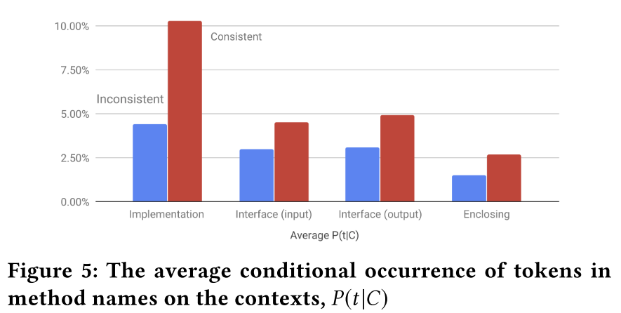
Empirical Study
Method Names and Contexts
Conditional occurrences of tokens in inconsistent and alternative good names on the contexts.
For all contexts, the average P(t|C) of the tokens in inconsistent method names is relatively much lower than that in the alternative consistent names.
Thus, each context can provide the indication of the occurrences of the tokens in good names more than those in inconsistent names.

Slide 14
Empirical Study
Our results provide empirical evidence to confirm the principle of naturalness of software that also holds for the tokens composing the names of the methods and the names of program entities in the contexts.
Conclusion:
(1) 62.9% of the full method names are unique. For a given method, one cannot rely solely on searching for a good name in the data of the previously seen method names.
(2) 78.1% of the tokens in method names can be found in the other previously seen method names.
(3) There are high proportions of the tokens (average of 65.0%) of method names which are shared with the three contexts.
(4) When encountering all the tokens of the name of the program entities used in the body of a method, in 35.9% of the cases, we could see a token in the method’s name.
(5) Even the tokens are not found in the contexts, one could use the contexts to predict the tokens in the method names due to those high conditional occurrences.
(6) Each context provides the indication of occurrences of the tokens in the good names more than in inconsistent names.

Slide 15
MNIRE: Consistency Checking Model
MNire, a machine learning approach to generate the candidate good name for a given method, and use it to compare with the current method name to check its consistency.
Key Ideas
Naturalness of Names at Token Level.
Observing the tokens of program entities in the three contexts from a large corpus, MNire can leverage that to derive the most likely tokens in the method names:
implementation context (how the method is implemented), including the names of the variables, fields, and methods that are used, accessed, or invoked in the method’s body.
interface context (the method’s input/output), including the parameters’ types and the return type of the method.
enclosing context (the enclosing class), including the class name’s tokens.

Slide 16
MNIRE: Consistency Checking Model
MNire, a machine learning approach to generate the candidate good name for a given method, and use it to compare with the current method name to check its consistency
Key Ideas
Abstractive Summarization.
Consider the method name as the abstract on the method’s functionality, which is expressed via the three above contexts.
To produce an abstract for a method, we use a machine learning model, called Encoder-Decoder

Slide 17
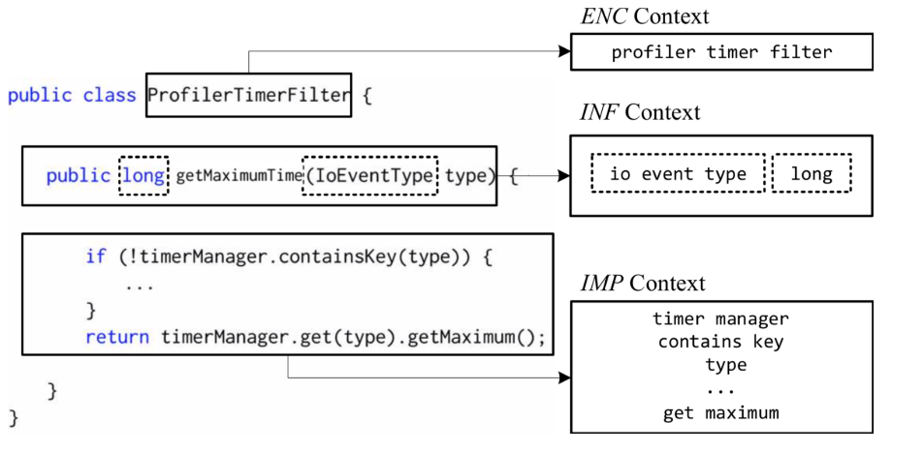
MNIRE: Consistency Checking Model
Context Extraction
Extract the implementation (IMP), interface (INF) and enclosing (ENC) contexts.
IMP is the set of tokens of the variables/fields and methods that are used in the method body.
INF context of the method includes two parts:
the set Input of the tokens from the parameters’ types, e.g., {io event type}
the set Output of the tokens from the return type, e.g., long.
ENC contains the tokens from the enclosing class name, e.g., profiler timer filter.
All the contextual sentences are then concatenated to form the sequential representation of the three contexts, that are separated by the periods (“.”).

Slide 18
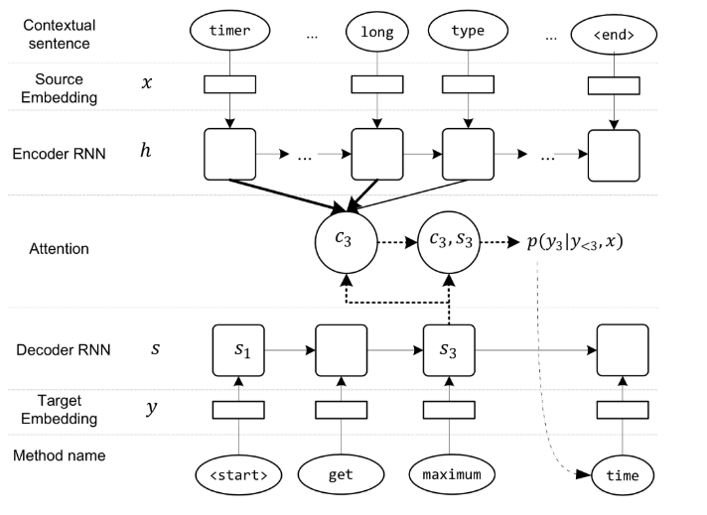
MNIRE: Consistency Checking Model
Abstractive Summarization Model
Model is based on an encoder-decoder architecture with attention mechanism.

Slide 19
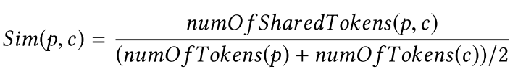
MNIRE: Consistency Checking Model
Method Name Consistency Checking
Compute the similarity Sim(p, c) between the name p produced by MNire and the current name c.
Sim(p, c) ∈ [0, 1], is defined as the portion of the tokens that are shared between p and c:
where numOfSharedTokens(p, c) is the number of the shared tokens of p and c, numOfTokens(p) and numOfTokens(c) are the numbers of tokens ofp and c.
The consistency of the methodm is decided using a varied threshold T. In particular, if Sim(p, c) ≤ T, MNire classifies c as inconsistent, otherwise c is classified as consistent with the method’s implementation.

Slide 20
Empirical Methodology
RQ3: Accuracy and Comparison. How accurate is MNire in method name consistency checking and recommending? and how is it compared with the state-of-the-art approaches for method name consistency checking in and method name recommending?
RQ4: Context Analysis. How do the three contexts contribute to MNire’s accuracy in MCC and MNR in different settings?
RQ5: Sensitivity Analysis. How do various factors affect MNire’s performance, such as representations, data’s sizes, thresholds?
RQ6: Time Complexity. What is MNire’s training/testing time?
RQ7: Usefulness. How useful is MNire in MCC and MNR?

Slide 21
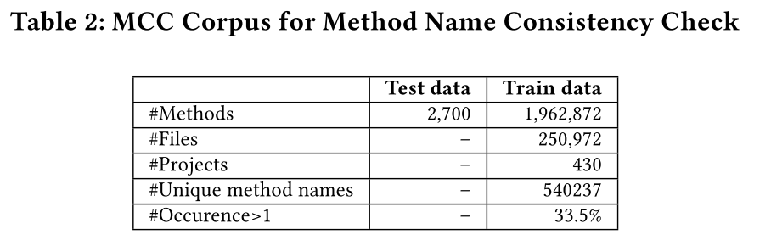
Empirical Methodology
Datasets
Corpus for Method Name Consistency Checking
training dataset: the latest versions of 430 Java projects with at least 100 commits. In total, it has 1,960,872 methods, which were considered by Liu et al. [1] as good/consistent names because they selected the methods whose names have been stable for a long time.
testing dataset: 2,700 methods in which half of them are labelled as consistent and the other half as inconsistent.
For the inconsistent ones, the authors chose the methods whose names have been modified/replaced by developers in the projects for the reasons of confusing or inconsistent names
[1] Learning to Spot and Refactor Inconsistent Method Names. (ICSE-2019)

Slide 22
Empirical Methodology
Datasets
Corpus for Method Name Recommendation
Followed the same setting and procedure with code2vec to build the corpus.
Collected 10K top-ranked, public Java projects on GitHub. The MNR corpus contains about 14.5M methods and 1.8M unique files.
All the files in all the projects are shuffled and split into 1.7M training and 61K testing files, i.e., 14M training and 458K testing methods.

Slide 23
Empirical Methodology
Datasets
In the experiments for RQ4, RQ5 and RQ6, we split the corpus based on the number of projects, instead of files. The project-based setting reflects better the real-world usage of MNire where it is trained on the set of existing projects and used to check for a new project.

Slide 24
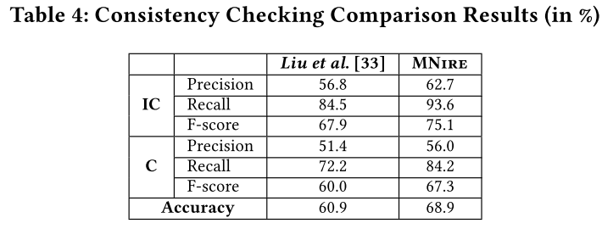
Empirical Results
Accuracy Comparison (RQ3)
Accuracy on Method Consistency Checking
For the IC classification, MNire’s recall and precision are 10.4% and 10.8% relatively higher than Liu et al.
their tool renames all the local variables of the same type T to a single name, TVar. This increases the similarity of methods that actually implement different tasks.
For the C classification, MNire detects better consistent names than Liu et al. with relatively higher recall (16.6%) and precision (9%).
There are consistent methods which are similarly implemented, however are named differently. There are also other cases in which two methods are named the same, but implemented in different ways for different tasks.

Slide 25
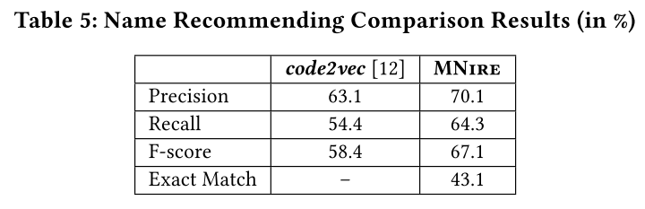
Empirical Results
Accuracy Comparison (RQ3)
Accuracy on Method Name Recommendation
MNire achieves relatively higher than code2vec in both recall (18.2%) and precision (11.1%).
Reason for code2vec to have a lower recall: source code with different structures can have similar names. In this case, code2vec recommends two different names.
Reason for MNire’s higher precision over code2vec: there are cases in which two methods are realized in the same structure, but are named differently since they are in different classes for different purposes.

Slide 26
Empirical Results
Accuracy Comparison (RQ3)
Generative Capability to Infer Previously Un-seen Method Names
There are +60K (13.1%) out of +460K generated cases that were not seen during training.
The precision and recall of this set of generated ones are 59.8% and 58.3%, respectively. Especially, in 16.8% of these generated cases (i.e., 2.2% total cases), the generated names exactly match with the expected ones in the oracle.
MNire predicts well even the un-seen method names. This shows that it learns to suggest the method names, rather than retrieving what have been stored in the training corpus.

Slide 27
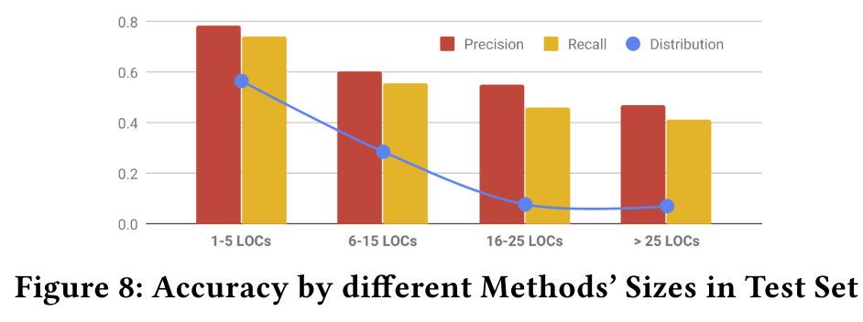
Empirical Results
Accuracy Comparison (RQ3)
Accuracy by the Sizes of Methods in Test Set

Slide 28
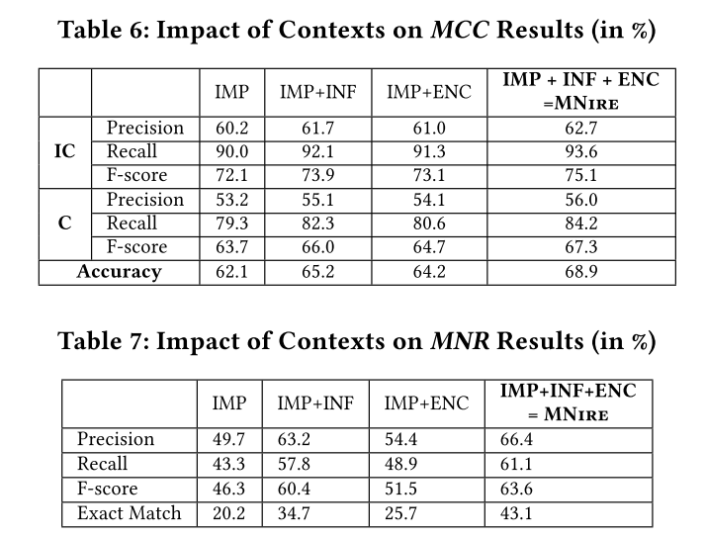
Empirical Results
Context Analysis Results (RQ4)
Notes:
impact of INF

Slide 29
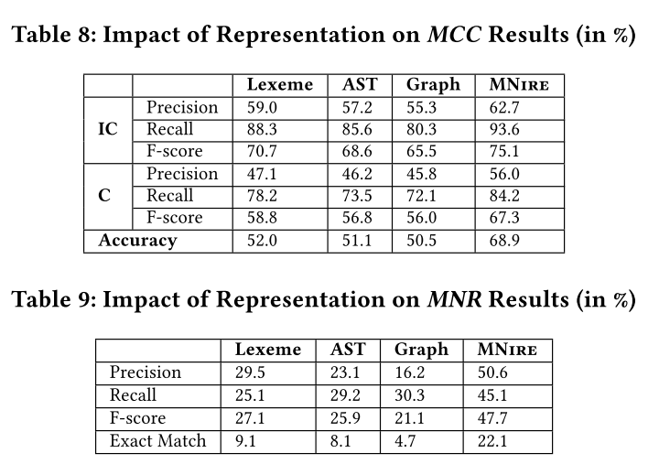
Empirical Results
Sensitivity Results (RQ5)
Accuracy with Different Representations.
the more sophisticated representations are used, the lower accuracies in both MCC and MNR.
The representations of the method bodies such as text, tree, graph, are important for code structures, however for method naming, the naturalness factor, i.e., the program entities’ names are more deciding factors.

Slide 30
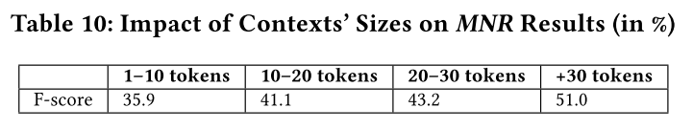
Empirical Results
Sensitivity Results (RQ5)
Impact of Contexts’ Sizes on Accuracy
With longer contexts (having more tokens), MNire performs better as it has seen more possible tokens. Thus, using training data with longer contexts is better.

Slide 31
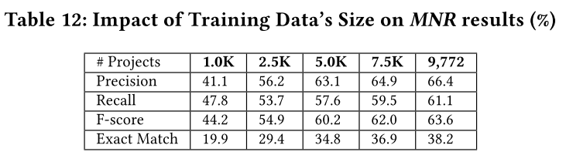
Empirical Results
Sensitivity Results (RQ5)
Impact of Training Data’s Size on Accuracy

Slide 32
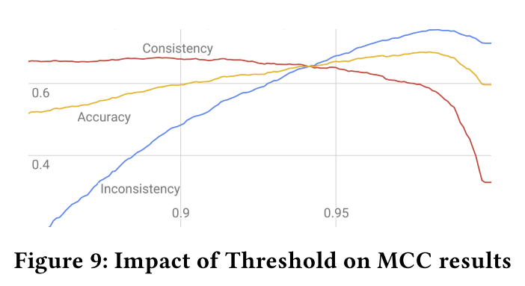
Empirical Results
Sensitivity Results (RQ5)
Impact of Threshold for MCC
The point which balances the F-scores of IC and C at 64.7% is T = 0.94.

Slide 33
Empirical Results
Time Complexity (RQ6)
All experiments were run on a Windows workstation with 16 Intel Xeon 3.7GHz processors, 32GB RAM, and a single Quadro P5000.
For MCC, MNire took 3 hours for training, and classified with a rate of 530 methods/second.
For MNR, it took 15 hours for training, compared to 30 hours by code2vec with a higher performance GPU (Tesla K80).

Slide 34
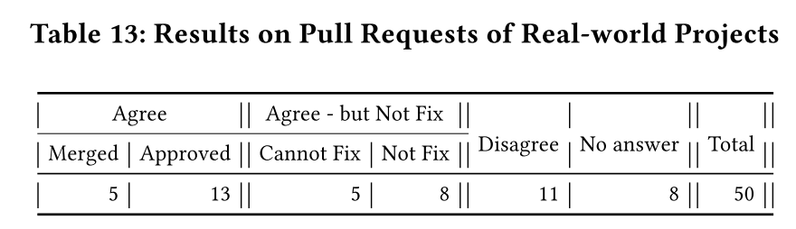
Empirical Results
Live Study on Real Developers (RQ7)
To evaluate MNire’s usefulness, we conducted a study on active open-source projects in which we submitted pull requests (PRs) of method renaming suggested by MNire and assess PR acceptance rates.
To avoid much work for developers, we randomly selected only 50 cases of inconsistent method names and suggested names.

Slide 35
Conclusion
To suggest a good name for a method, relying on the naturalness of the program entities in the contexts yields better results than using the AST or PDG structures.
Method names are quite unique, however, the tokens composing them are repeated frequently. Thus, MNire exploits the regularity of the tokens in program entities’ names for method name suggestion.
Our generative approach is more effective in producing new names than IR-based search approach in a corpus.

Slide 36
Thanks!

